Slide 1
Educational Organisation using ServiceNow
Project completed by team members
THANALAKSHMI D
VIDHYASRI D
VISHNUPRIYA P
YASMIN T

Slide 2
Introduction to ServiceNow in Education
ServiceNow is a powerful platform that enables educational institutions to streamline processes, improve efficiency, and enhance the overall student experience. This project demonstrates the implementation of ServiceNow in an educational organization, highlighting its benefits and advantages.

Slide 3


Slide 4
ADVANTAGES OF SERVICENOW IN EDUCATION
Improved Efficiency: Automate routine tasks and reduce manual effort.
Enhanced Student Experience: Provide a single platform for students to access various services and resources.
Streamlined Processes: Standardize and simplify processes across departments.
Better Data Management: Gain insights and make data-driven

Slide 5
Benefits of implementing ServiceNow
Increased Productivity: Reduce time spent on manual tasks and focus on strategic initiatives.
Reduced Costs: Minimize waste and optimize resources.
Improved Decision-Making: Make informed decisions with data-driven insights.
Enhanced Collaboration: Foster a culture of collaboration and communication across departments.

Slide 6
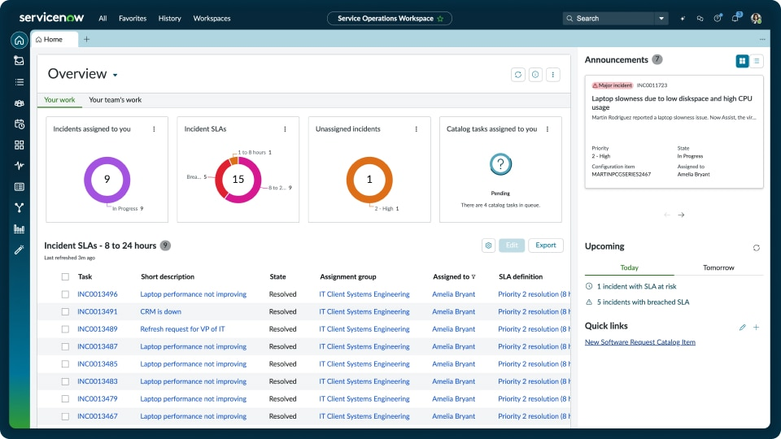
INCIDENT MANAGEMENT CONSOLE

Slide 7
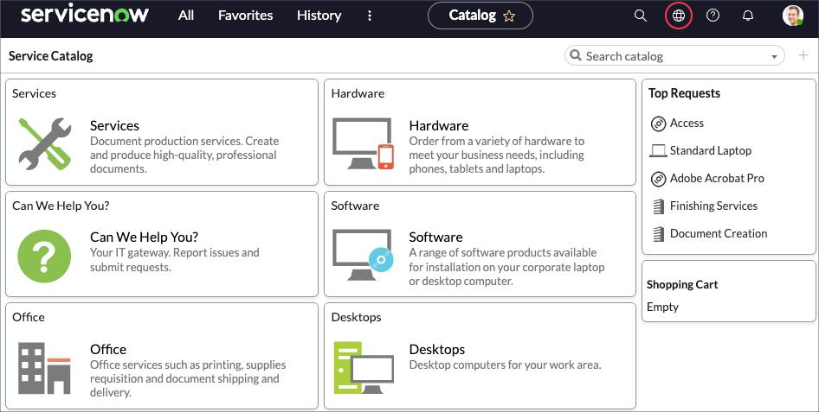
SERVICE CATALOG PORTAL

Slide 8
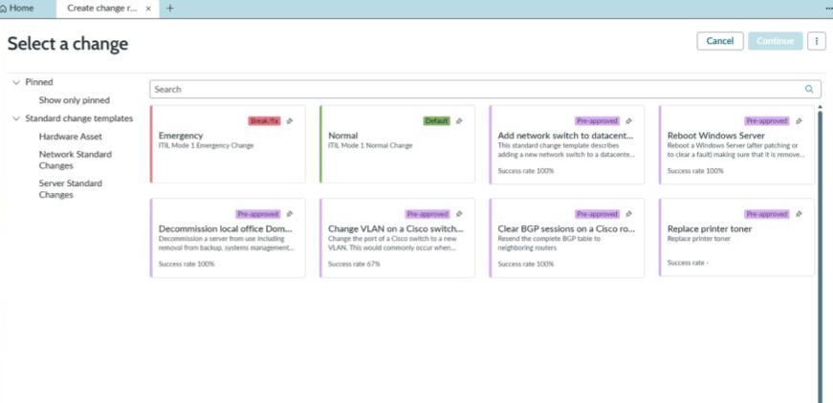
CHANGE MANAGEMENT PROCESS

Slide 9
How it’s useful
ServiceNow provides a single platform for educational institutions to manage various processes, automate routine tasks, and enhance the student experience. By leveraging ServiceNow, institutions can improve efficiency, reduce costs, and make data-driven decisions.

